Slide 1
Data Analysis On Rotten Tomatoes Movie Reviews

Slide 2
Team:
1)
2)

Slide 3
Objective:
Each record in the movies collection corresponds to a movie that is listed on Rotten Tomatoes and includes the URL used for scraping, movie tile, description, genres, running time, director, actors, users' ratings, and critics' ratings. Each item in the critic's dataset corresponds to a critic review that was posted on Rotten Tomatoes and includes the URL used for the scraping, the critic's name, the publication date, the review's score, and its text.
Problem Statement:
To find and extract the Valid data in the dataset.
To find of positive reviews in a Word cloud format.
To find of negative reviews in a Word cloud format.
Created a model that can correctly predict the overall rating of a new review based on its text content and related features in online reviews and associated ratings
Developed a model that accurately predicts the sentiment (positive, negative, or neutral) of review based on the substance of its language and related elements?
Designed the analysis which picks the top reviews from the whole reviews which helps for better understanding the preferences and opinions of the movie?
Determined the review frequency throughout the entire reviews length of the movie?

Slide 4
Data Stages:
The Netflix dataset's accurate data to locate and extract.
The Netflix dataset
a to locate and extract.
Raw Dataset
Data Cleaning And Transformation
Data Visualization

Slide 5
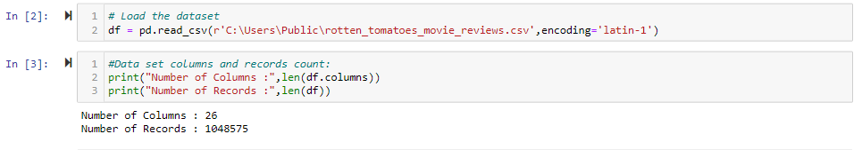
DATASET Details: 1048575 Records, 26Columns

Slide 6
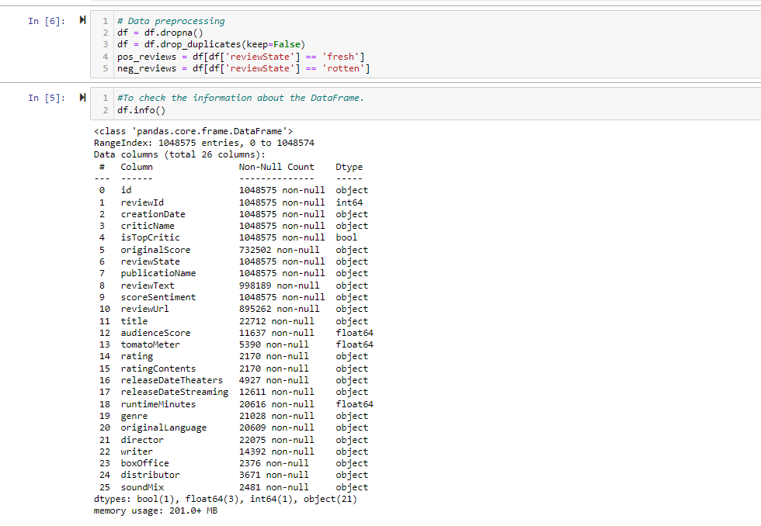
To find and extract the Valid data in the dataset:
We have removed the duplicates and Null Values from the data frame.

Slide 7
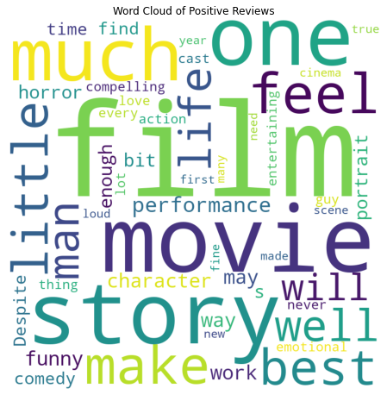
To find of positive reviews in a Word cloud format:

Slide 8
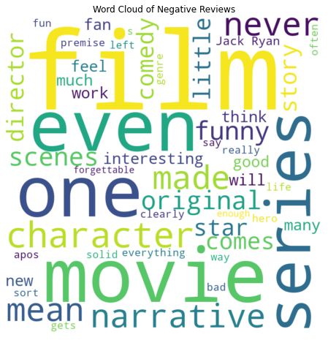
Created a model that can correctly predict the overall rating of a new review based on its text content and related features in online reviews and associated ratings:

Slide 9
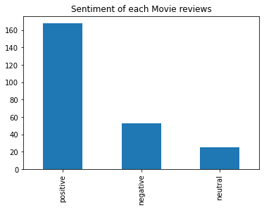
Developed a model that accurately predicts the sentiment (positive, negative, or neutral) of review based on the substance of its language and related elements?

Slide 10
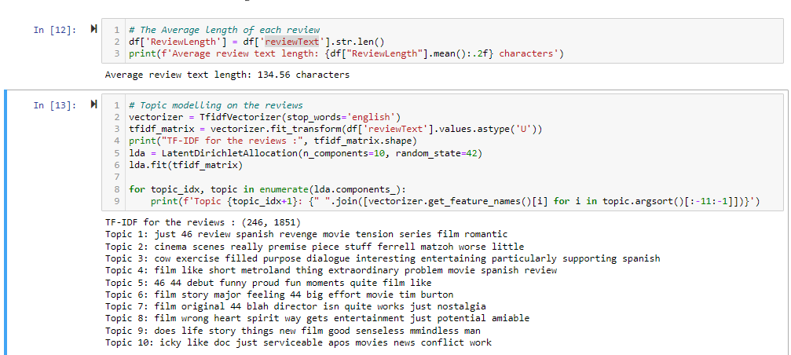
Designed the analysis which picks the top reviews from the whole reviews which helps for better understanding the preferences and opinions of the movie:

Slide 11
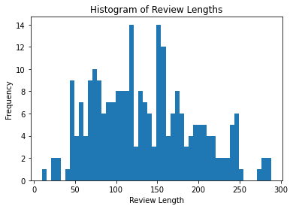
Determined the review frequency throughout the entire reviews length of the movie?

Slide 12
THANK YOU

